Slide 1

SNIPE TEAM
5 January 2018
www.snipe.co.in
1
Notes:
1

Slide 2

CONTENTS
Introduction to REST
What is Restful web service
Features
Resources
Messages
Addressing
Methods
Statelessness
Caching
Jax-RS
RAML
Using Joins

Slide 3
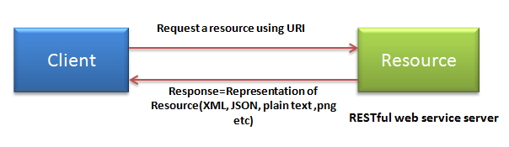
Introduction to REST
REST was first introduced by Roy Fielding in year 2000.
REST stands for Representational State Transfer.
In the REST architecture style, clients and servers exchange representations of resources by using a standardized interface and protocol.
In REST architecture, a REST Server simply provides access to resources and the REST client accesses and presents the resources.

Slide 4
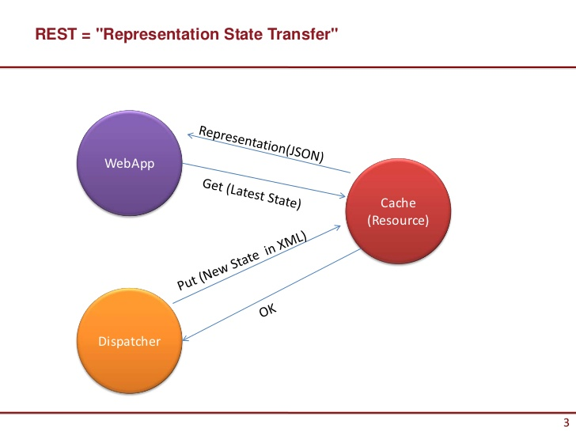
REST

Slide 5
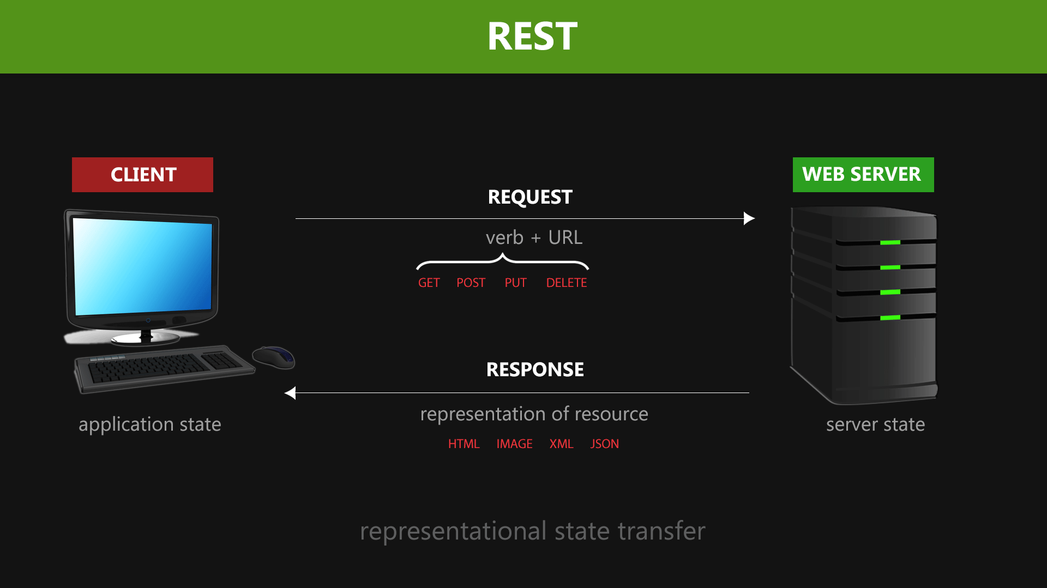

Slide 6
Restful WebService
A web service is a collection of open protocols and standards used for exchanging data between applications or systems.
Web services based on REST Architecture are known as RESTful Web Services.
These web services use HTTP methods to implement the concept of REST architecture.
A RESTful web service usually defines a URI (Uniform Resource Identifier), which is a service that provides resource representation such as JSON and a set of HTTP Methods.

Slide 7
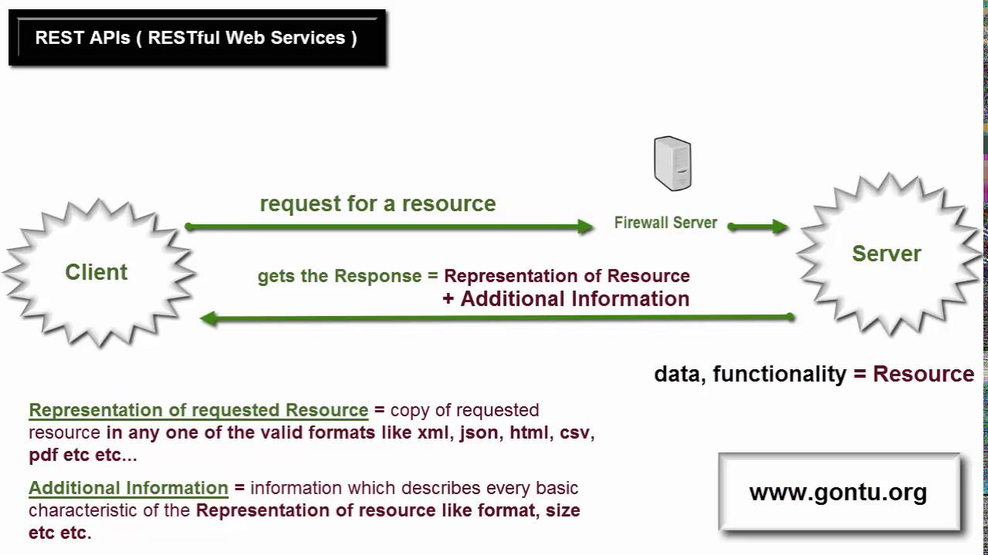
REST API

Slide 8
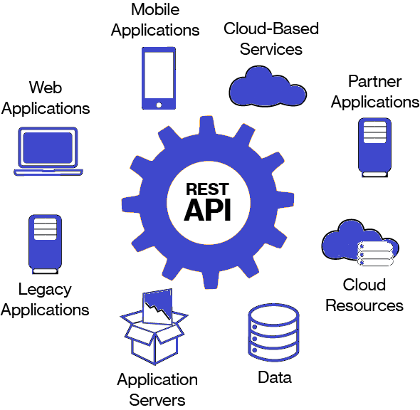
Features of Restful web services :
Features
Resource identification through URI:Resources are identified by their URIs (typically links on internet). So, a client can directly access a RESTful Web Services using the URIs of the resources (same as you put a website address in the browser’s address bar and get some representation as response).
Uniform interface: Resources are manipulated
using a fixed set of four create, read, update,
delete operations: PUT, GET, POST, and DELETE.
Client-Server: A clear separation concerns is the
reason behind this constraint. Separating concerns
between the Client and Server helps improve
portability in the Client and Scalability of the
server components.

Slide 9
Stateless: each request from client to server must contain all the information necessary to understand the request, and cannot take advantage of any stored context on the server.
Features
the resources are interconnected using URLs, thereby enabling a client to progress from one state to another.
Layered components – intermediaries, such as proxy servers, Cache: to improve network efficiency responses must be capable of being labeled as cacheable or non-cacheable.
Named resources – the system is comprised of resources which are named using a URL.
Interconnected resource presentations – the representations of servers, gateways, etc, can be inserted between clients and resources to support performance, security, etc.

Slide 10
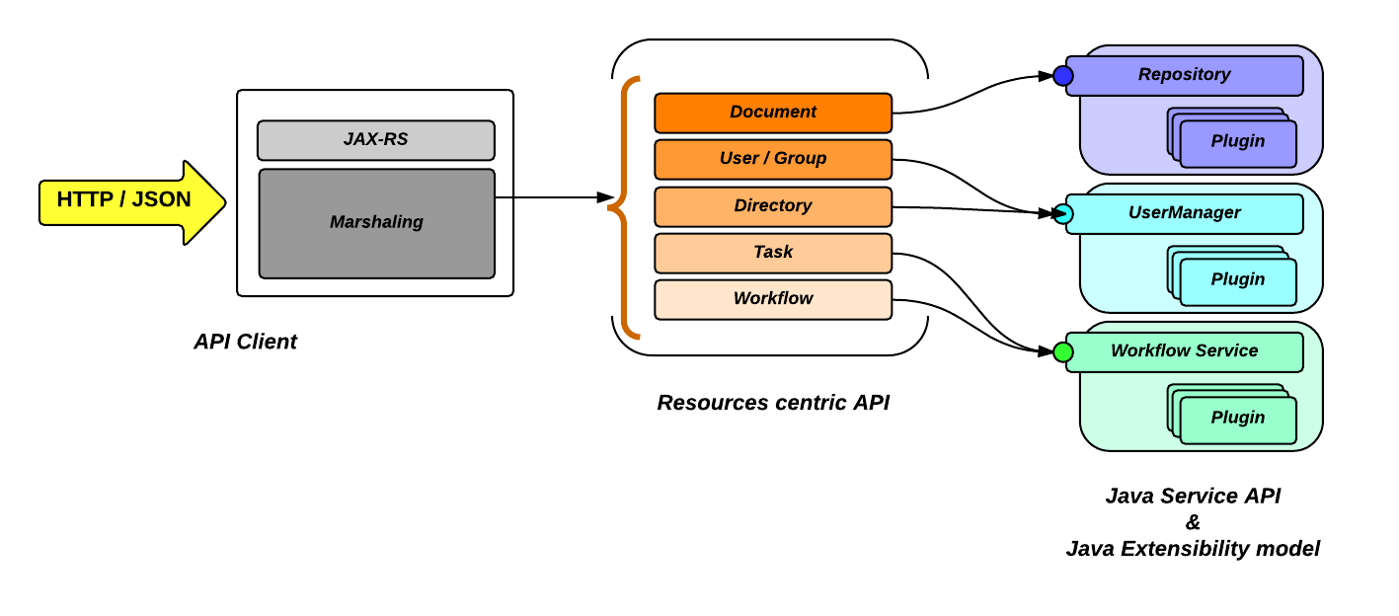
Resources
Resources
REST architecture treats every content as a resource.
These resources can be Text Files, Html Pages, Images, Videos or Dynamic Business Data.
REST Server simply provides access to resources and REST client accesses and modifies the resources.
Here each resource is identified by URIs/ Global IDs.
REST uses various representations to represent a resource where Text, JSON, XML.

Slide 11
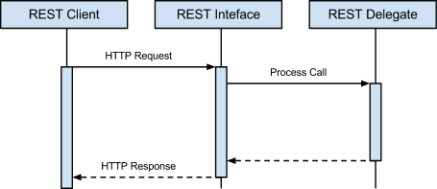
Message
RESTful Web Services make use of HTTP protocols as a medium of communication between client and server.
A client sends a message in form of a HTTP Request and the server responds in the form of an HTTP Response.
This technique is termed as Messaging. These messages contain message data and metadata i.e. information about message itself.

Slide 12
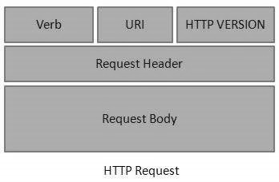
HTTP Request
An HTTP Request has five major parts −
Verb − Indicates the HTTP methods such
as GET, POST, DELETE, PUT, etc.
URI − Uniform Resource Identifier (URI) to
identify the resource on the server.
HTTP Version − Indicates the HTTP version. For example, HTTP v1.1.
Request Header − Contains metadata for the HTTP Request message as key-value pairs. For example, client (or browser) type, format supported by the client, format of the message body, cache settings, etc.
Request Body − Message content or Resource representation.

Slide 13
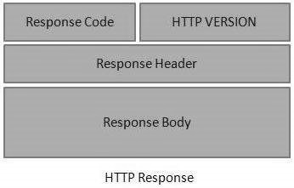
HTTP Response
An HTTP Response has four major parts −
Status/Response Code − Indicates the
Server status for the requested resource.
For example, 404 means resource not
found and 200 means response is ok.
HTTP Version − Indicates the HTTP version. For example HTTP v1.1.
Response Header − Contains metadata for the HTTP Response message as key value pairs. For example, content length, content type, response date, server type, etc.
Response Body − Response message content or Resource representation.

Slide 14
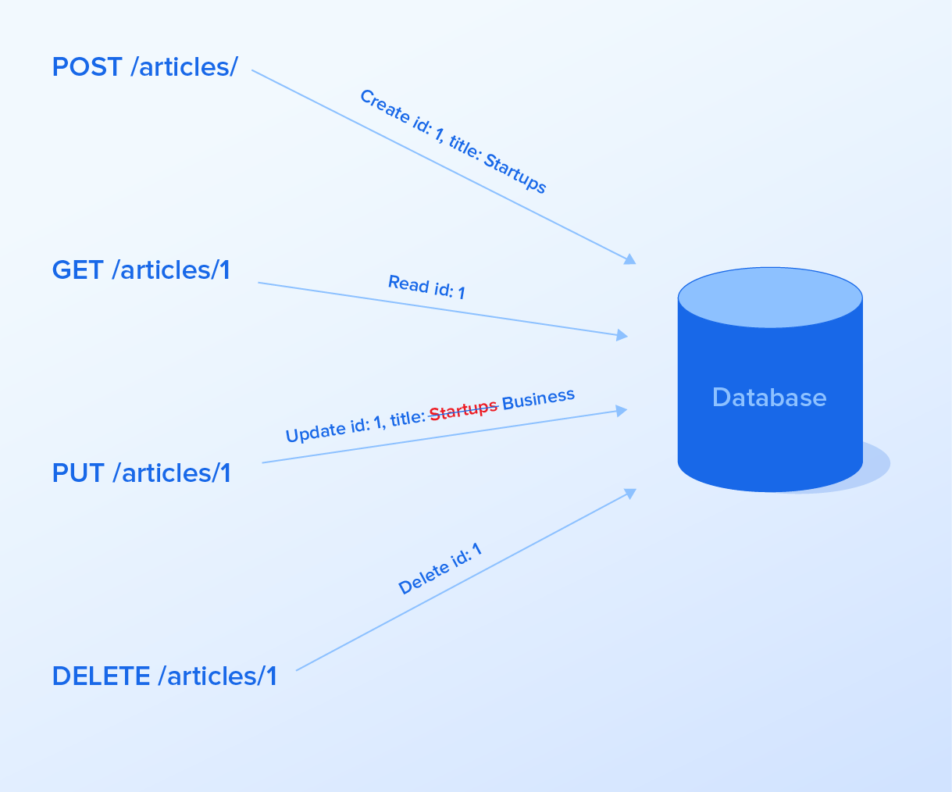
Methods
GET: Use GET requests to retrieve resource representation/information only – and not to modify it in any way.
POST: Use POST APIs to create new subordinate resources.
PUT: Use PUT APIs primarily to update existing resource.
DELETE: As the name applies, DELETE
APIs are used to delete resources.
PATCH: HTTP PATCH requests are to
make partial update on a resource.

Slide 15
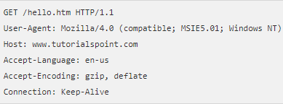
GET Method Request
GET:
The GET method requests a representation of the specified resource. Requests using GET should only retrieve data.
User-Agent:
Request header contains a characteristic string that allows the network protocol peers to identify the application type, operating system, software vendor or software version of the requesting software user agent.
Host
The domain name of the server.
Accept-language:
Request HTTP header advertises which
languages the client able to understand.
Request

Slide 16
Cont...
Accept-Encoding:
Request HTTP header advertises which content
en-coding, usually a compression algorithm ,the client is able to understand.
Connection:
General header controls whether or not the network connection stay open after the current transaction finisher.
If the value is set to keep-alive, the connection is not closed.

Slide 17
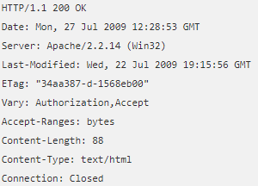
GET Method Response
Server:
Header contains information about the software used by the origin server to handle the request.
ETag:
HTTP response header is an identifier for a specific version of resource . It allows caches to be more efficient and saves bandwidth.
Vary:
It is used by the server to indicate which headers
it used when selecting a representation of a
resource .
Content-length:
It is to indicating the size of the entity body in
bytes send to the recipient.
Response

Slide 18
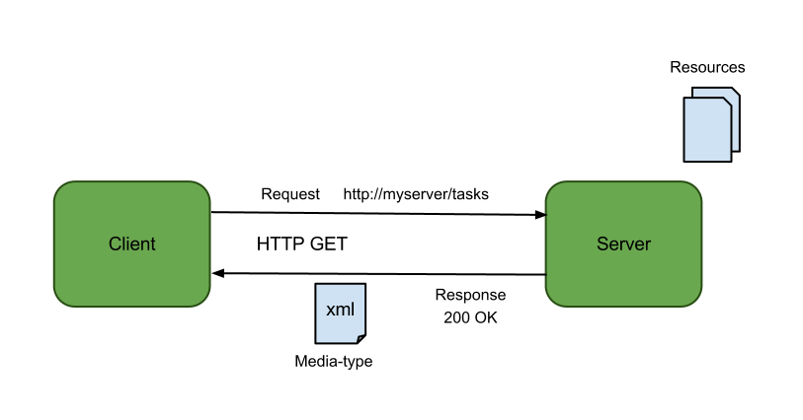
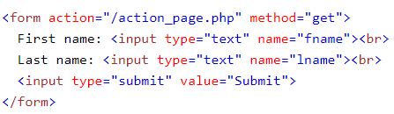
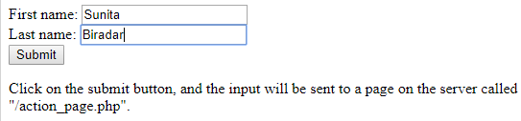
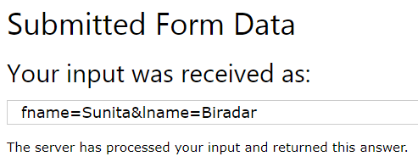
GET Method

Slide 19
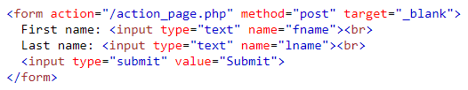
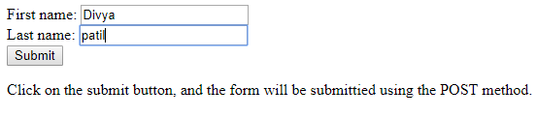
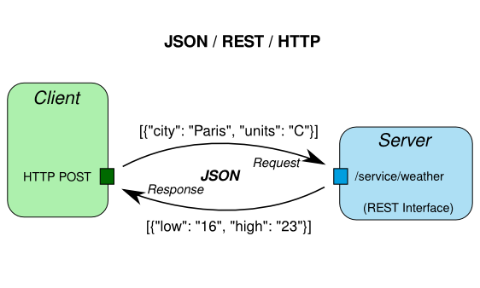
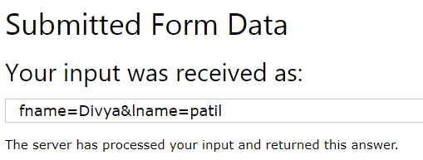
POST Method

Slide 20

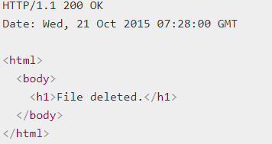
Delete Method
Request
Response

Slide 21
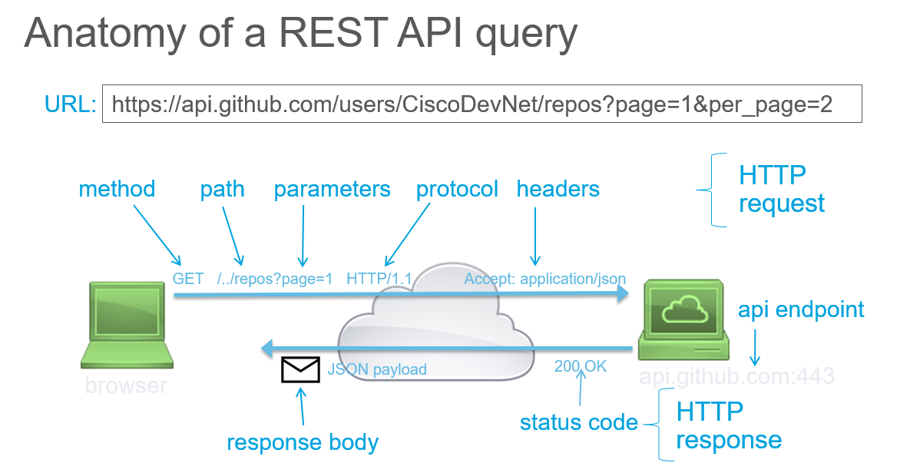
Addressing
Addressing refers to locating a resource or multiple resources lying on the server.
It is analogous to locate a postal address of a person.
Each resource in REST architecture is identified by its URI (Uniform Resource Identifier). A URI is of the following format −
<protocol>://<servicename>/<ResourceType>/<ResourceID>

Slide 22
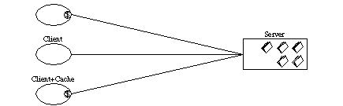
Statelessness
As per the REST architecture, a RESTful Web Service should not keep a client state on the server. This restriction is called Statelessness.
It is the responsibility of the client to pass its context to the server and then the server can store this context to process the client's further request.

Slide 23
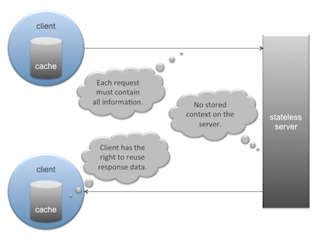
Caching
Caching refers to storing the server response in the client itself, so that a client need not make a server request for the same resource again and again.
A server response should have information about how caching is to be done, so that a client caches the response for a time-period or never caches the server response.

Slide 24
HTTP Code
200 : OK − shows success.
201 : CREATED − when a resource is successfully created using POST or PUT request. Returns link to the newly created resource using the location header.
204 : NO CONTENT − when response body is empty. For example, a DELETE request.
304 : NOT MODIFIED − used to reduce network bandwidth usage in case of conditional GET requests. Response body should be empty. Headers should have date, location, etc
400 : BAD REQUEST − states that an invalid input is provided. For example, validation error, missing data.

Slide 25
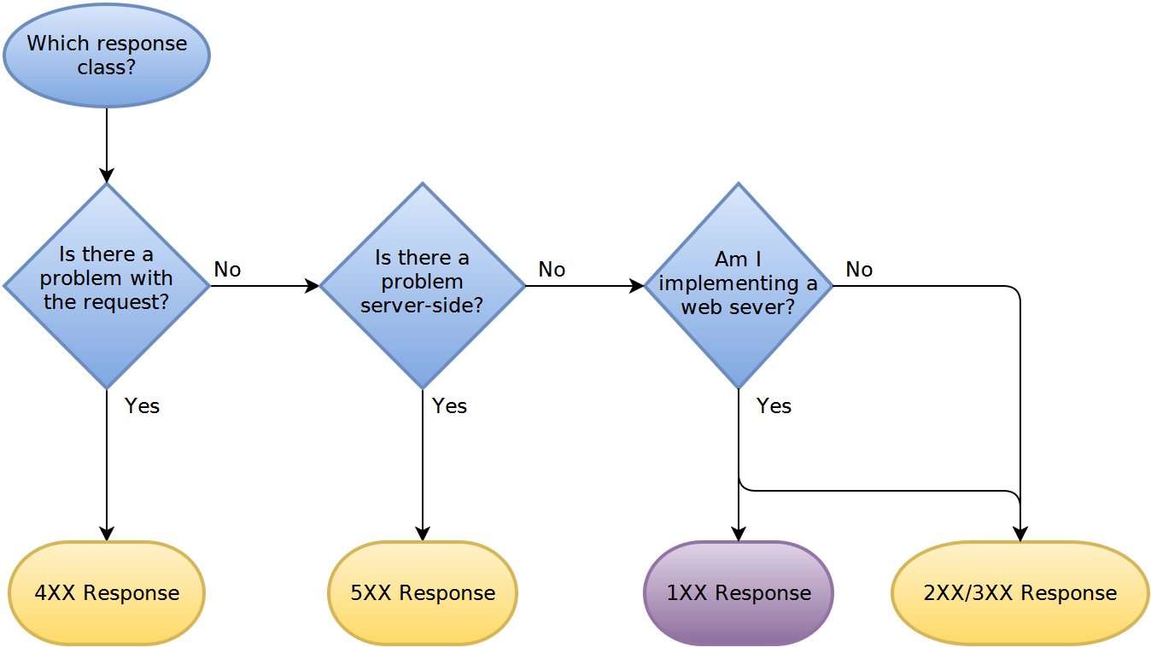
HTTP Code

Slide 26
401 : UNAUTHORIZED − states that user is using invalid or wrong authentication token.
HTTP Code
403 : FORBIDDEN − states that the user is not having access to the method being used. For example, Delete access without admin rights.
404 : NOT FOUND − states that the method is not available.
409 : CONFLICT − states conflict situation while executing the method. For example, adding duplicate entry.
500 : INTERNAL SERVER ERROR − states that the server has thrown some exception while executing the method.

Slide 27
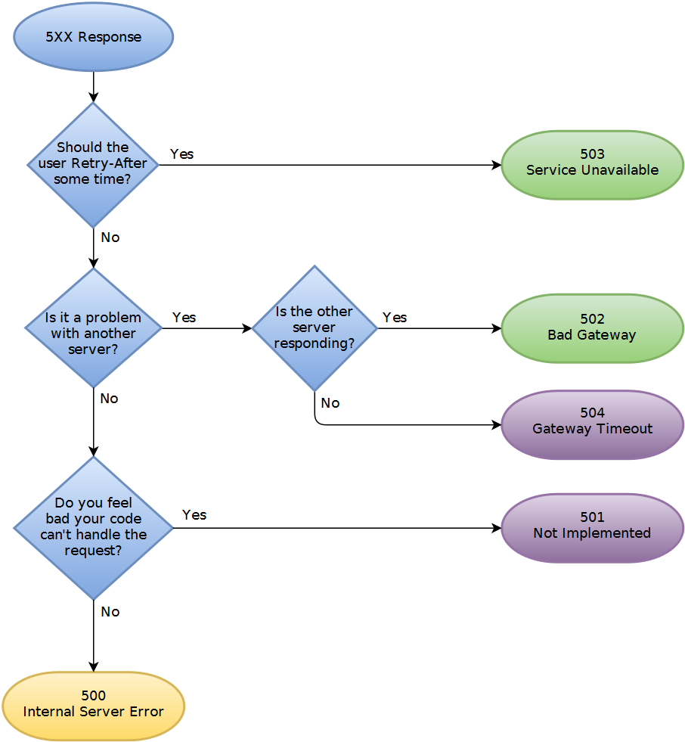
HTTP Code

Slide 28
JAX – RS
JAX-RS stands for JAVA API for RESTful Web Services.
JAX-RS is a JAVA based programming language API and specification to provide support for created RESTful Web Services
Java API for RESTful Web Services is a Java programming language API spec that provides support in creating web services according to the Representational State Transfer architectural pattern.

Slide 29
Jersey
Jersey RESTful Web Services framework is an open source framework for developing RESTful Web Services in Java.
It provides support for JAX-RS APIs and serves as a JAX-RS Reference Implementation.

Slide 30
RAML
Introduction
RAML API Schema
Root
Resources
Methods
URI Parameters
Query Parameters
Responses

Slide 31
Introduction
What is RAML?
RAML stands for RESTful API Modeling Language.
It is a YAML based language for defining RESTful APIs and contains all the necessary information to describe RESTful APIs.
YAML is a data serialization language that is easier to read and understand than other formats like XML or JSON.

Slide 32
RAML
Why RAML ?:
Makes it easy to manage the whole API lifecycle from design to sharing.
Concise - you only write what you need to define.
Reusable.
Machine readable API design that is actually human friendly.

Slide 33
API Schema
API Schema
Root
Some basic information about the API. i.e. title, baseUri, version etc.
Resources
Decides how API can be used by consumers.
Methods
To define what consumers can do with the resources.
URI Parameters
To have dynamic resources, to act upon the more granular objects of the resources.
Query Parameters
To be passed to methods, to extend the functionality of the API.
Responses
HTTP status codes, may include descriptions, examples or schemas

Slide 34
Root
Root
Contains Some basic information about the API. i.e. title, baseUri, version etc.
Everything entered in at the root (or top) of the spec applies to
the rest of the API.
Chosen baseURI will be used with every call made, hence make sure to keep it clean and concise.
Example :
#%RAML 0.8
title: Employee Details Management
version:v1
baseUri: https://mocksvc.mulesoft.com/mocks/c2a7ecf4-
edd3-4023-8373-c3a2cf325dda/api

Slide 35
Resources
Resources
Decides how API can be used by consumers.
Resources always begin with a slash ( / ) in RAML.
Any methods and parameters nested under these top level
resources belong to and act upon that resource.
Nesting of resources is also possible.
Example :
/employees:
/department:
/region:

Slide 36
Methods
Methods
To define what consumers can do with the resources.
Most common HTTP methods :
get : Retrieve the information defined in the request URI.
put : Replace the addressed collection. At the object-level, create or update it.
post : Create a new entry in the collection. This method is generally not used at the object-level.
delete : Delete the information defined in the request URI.
Each HTTP method can only be used once per resource.
Lower case must be used for methods in RAML API definition.
Example :
/employees:
get:
post:
put:

Slide 37
URI Parameters
URI Parameters
To have dynamic resources, to act upon the more granular objects of the resources.
Used for nesting of resources.
A URI parameter is denoted by surrounding curly brackets in RAML.
Example :
/employees:
/{employeeName}:
With above, to make a request to this nested resource, the URI for the employee, ‘Thomas Anderson’ would look like
http://api.EmpolyeeDet.com/v1/ employees/ Thomas Anderson

Slide 38
Query Parameters
Q Parameters
To be passed to methods, to extend the functionality of the API.
To make developers to be able to perform more powerful actions, like filtering a collection based on passed parameters.
Query parameters may also be something that the server requires to process the API consumer's request, like an access token.
Example :
/ employees :
/{employeeName}
get:
queryParameters:
employeeId :
put:
queryParameters:
access_token:

Slide 39
Responses
Responses
A map of one or more HTTP status codes.
Each response may include descriptions, examples or schemas
Note the pipe ( | ) after ‘example’ keyword, it’s to indicate what follows is a string, if not put, it’ll give an error saying, ‘example must be a string’

Slide 40
Example :
/ employees :
/{employeeName}:
get:
description: Retrieves details of a specific employee
responses:
200:
body: application/json:
example: |
{
…<sample data>

Slide 41
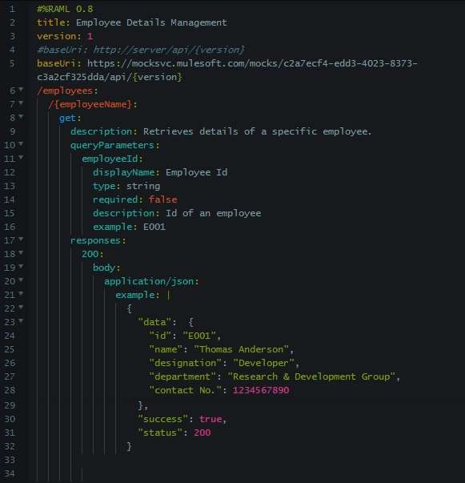
Root
Resource
Method
URI Parameter
Query Parameter
Note The Pipe
Response

Slide 42
Questions
What is your understanding of what are RESTful web services?
2) Name the protocol which is used by RESTful web services.
3) Explain the term ‘Addressing’ with respect to RESTful WEB service.
4) Enlist features of RESTful web services.
5) Explain messaging technique.
6) What are the core components of HTTP request and HTTP response?
7) Explain the term ‘Statelessness’ with respect to RESTful WEB service.
8) Enlist advantages and disadvantages of ‘Statelessness’.
9) Enlist some important constraints for RESTful web services.
10) What is a ‘Resource’?
11) Why proper representation of Resource is required?
12) Enlist some important points that should be kept in mind while designing Resources representation for RESTful web services.

Slide 43
13) What is Caching?
14) Explain Cache-control header.
15) What are the best practices that are to be followed while designing RESTful web services?
16) What is Payload?
17) Enlist some of the HTTP methods with description.
18) What is the difference between PUT method and POST method?
19) What is your understanding about JAX-RS?
20) What are HTTP status codes? Enlist few with meaning.

Slide 44
THANK YOU

